Slide 1
WEB APPLICATION
BASED
SCIENTIFIC
CALCULATOR

Slide 2
Submitted by:
Sparsh Vohra RA1911028010031 (Team Leader)
Swarnima Gupta RA1911028010032 (Team Member)
Manav Garg RA1911028010037 (Team Member)
Submitted TO: Dr. M Vimaladevi

Slide 3
PROBLEM
STATEMENT

Slide 4
PROBLEM STATEMENT:
Usually while working for long shifts of work where a lot concentration is needed a calculator is a much needed thing in the life of human which simplifies their work in day to day life. Every human uses calculator at least once in a day, so we can take a idea how much we are dependent on it.
So to make work easier and avoid any kind of distraction while working on PC we are making a web application based “Scientific Calculator” which is fast and has a clean user interface that will help to users to deal with more complex expression in a easier way.

Slide 5
REQUIREMENTS

Slide 6
REQUIREMENTS:
There are basically three types of requirements which includes Functional , Non-Functional and Infrastructure requirements.
Functional Requirements can also be expressed in the form of “user story” which is the smallest unit of work in an agile framework. It’s an end goal, not a feature, expressed from the software user’s perspective.
Non-Functional requirements includes Performance, Availability, Confidentiality, Scalability, Flexibility, Extensibility and Reliability.
Infrastructure Requirements includes workspace, PCs’ , internet and various kind of softwares.

Slide 7
Functional Requirements:
Requirement (#) | Requirement Specification | Department | Name of Business User
E1FR1 | Calculation | Programmers | Client
E1FR2 | Data manipulation | Programmers | Client
E1FR3 | Business Process | Marketing Team | Client
E1FR4 | User Interaction | Designing Team | Consumers

Slide 8
Non-Functional Requirements:
Requirement (#) | Category of NFR | Requirement Specification | Department | Name of Business User
NFR1 | Performance | All pages should load within 3 seconds | Backend Team | Clients
NFR2 | Performance | Search should bring the results less than 7 seconds | Backend Team | Clients
 | Availability | Application should be available for 24x7 | Backend Team | Clients
 | Scalability | Calculation Service should scale to serve 1000 request per second over 5 minutes time span | Backend Team | Consumers
 | Confidentiality | The source code should remain confidential | Programmers | Clients
E1NFR2 | Usability | The application can be used by everyone worldwide. | Project Team | Consumers
 | Flexibility | The application can be accessed anytime | Project Team | Consumers
E1NFR1 | Extensibility | The application can be used by anyone from any corner of the world. | Backend Team | Consumers
 | Reliability | The calculator will provide accurate and fast results | Backend Team | Consumers

Slide 9
Infrastructure Requirements:
Requirement (#) | Requirement Specification | Department | Name of Business User / Project Team Member
IR1 | A supercomputer with 64GB Ram, 5TB Hard-disk and 8GB graphic card. | Programmers | Sparsh Vohra
IR2 | Code Repository: GitHub | Programmers | Sparsh Vohra
IR3 | AWS Account | Backend team | Sparsh Vohra
IR4 | IDE – Visual Studio Code | Programmers | Sparsh Vohra

Slide 10
DESIGN

Slide 11
Design:
We tried to keep the design of the calculator minimal so anyone can operate it with ease. It looks like a normal calculator what we come across in our daily life. But what’s special about it is the design what makes it different from others.

Slide 12
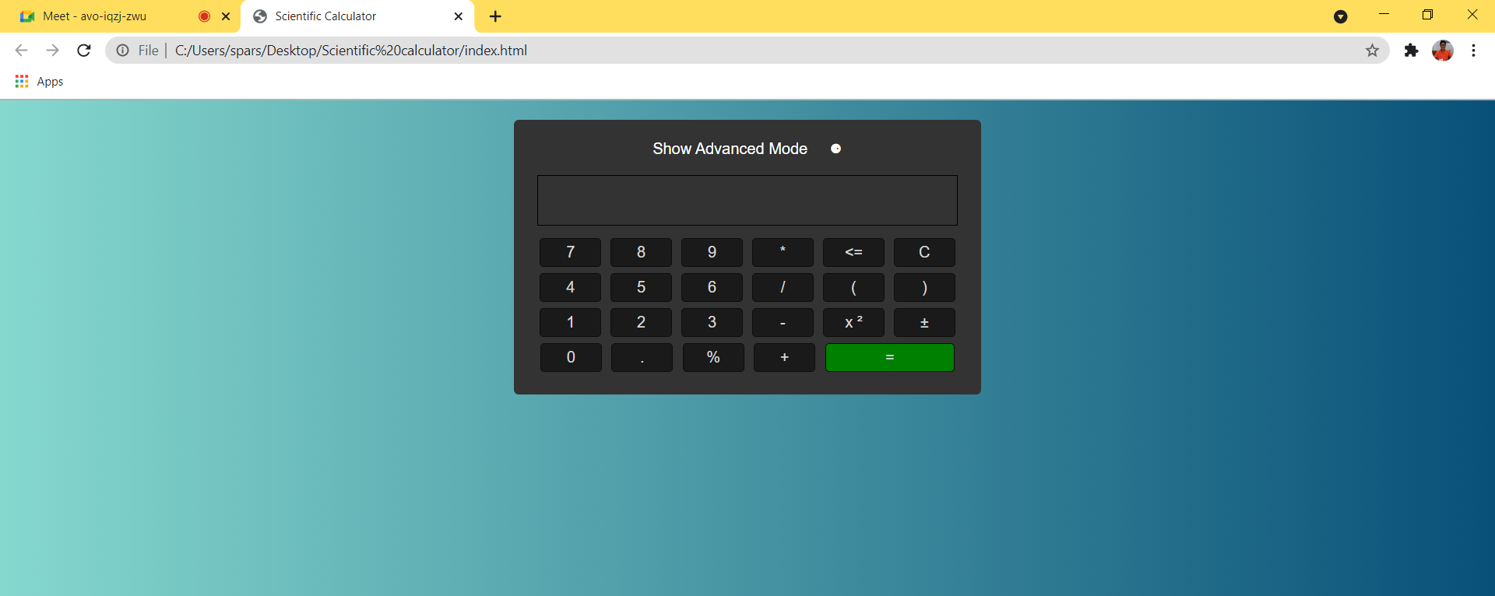
BASIC MODE

Slide 13
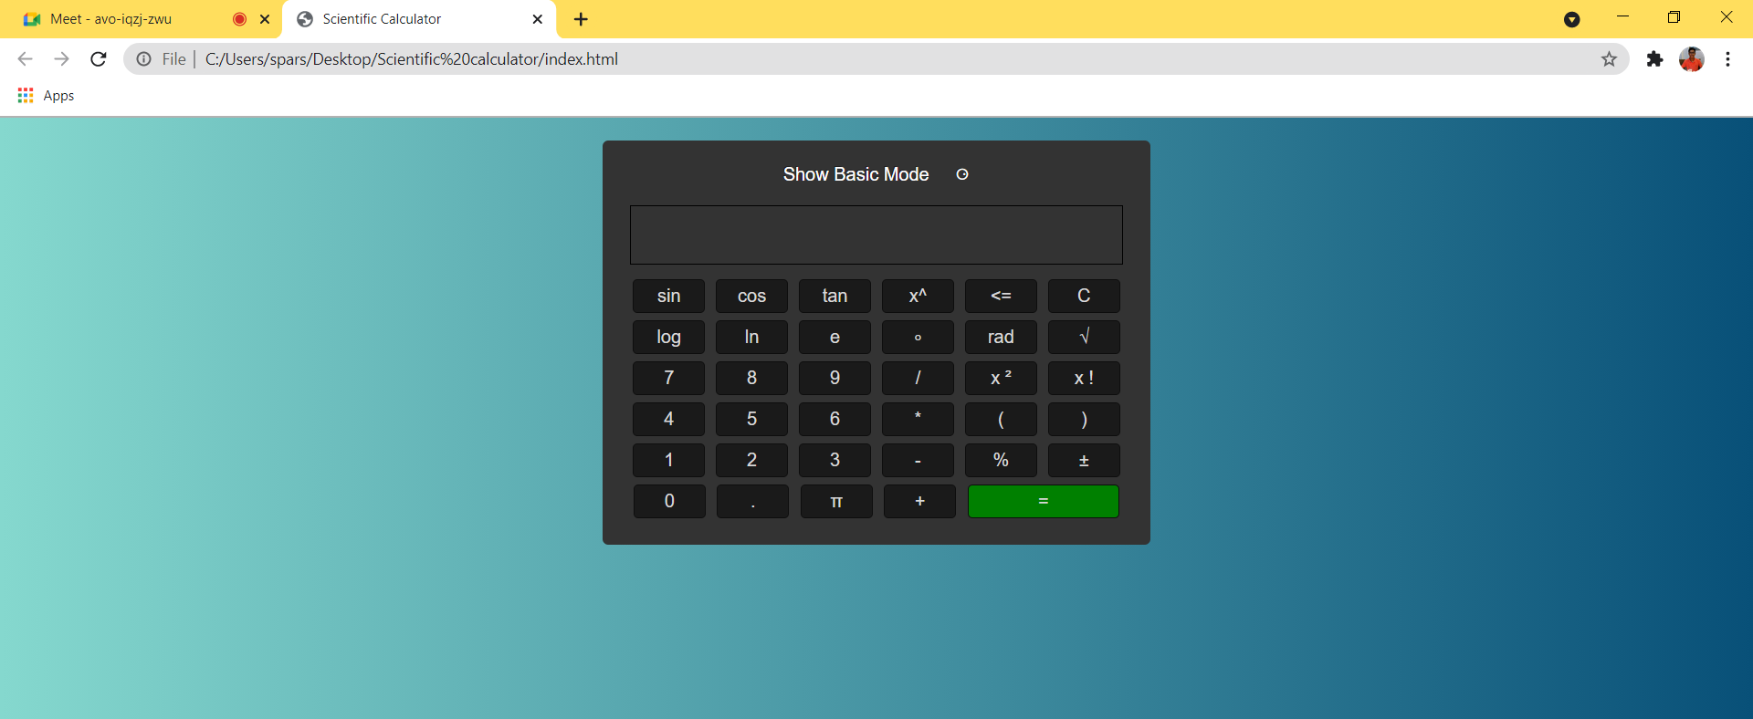
ADVANCED MODE

Slide 14
MODULES

Slide 15
MODULES
We have divided our project into three modules :
Module 1 consists the basic skeleton design of the calculator without any styling
Module 2 consists the styling code of the calculator . It includes the positioning of the buttons ,the color scheme etc.
Module 3 consists the functionality code .

Slide 16
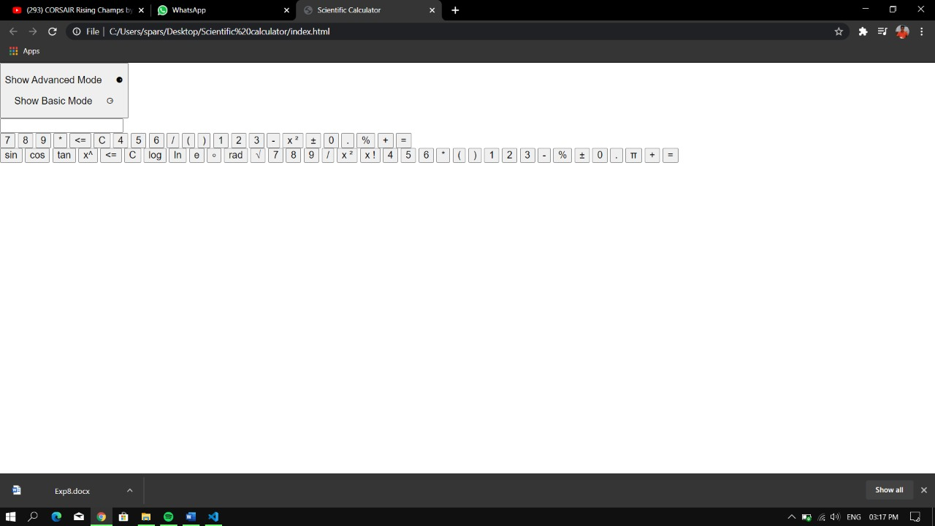
MODULE 1

Slide 17
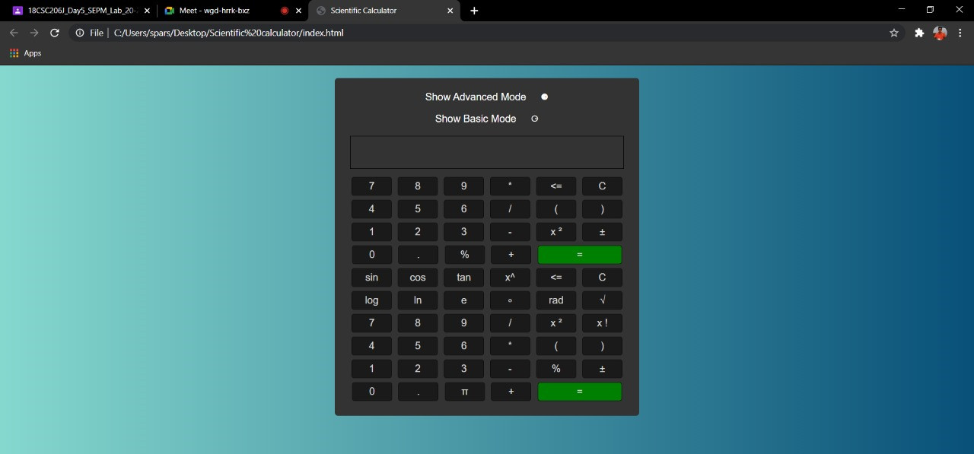
MODULE 2

Slide 18
MODULE 3

Slide 19
TEST CASES

Slide 20
Test Cases:
A test case consists of an input to the code and an expected output to verify a program's actual output against its expected output. It helps in validating your code by evaluating it automatically.
There are two types of test cases : Functional and Non-Functional
Functional test cases check the working of the different modules and functions
Non-Functional test cases tests the overall compatibility , performance, Usability of the website.

Slide 21
Functional Test Cases:
Test Scenario | Test Case | Execution Steps | Expected Outcome | Actual Outcome | Status | Remarks
Verify that the answer is displayed | One the equals button in clicked the answer is displayed | 1.User enter the combination of digits and operators 2.Clicks the equals button | The answer should be displayed on the output screen | The answer is displayed correctly | Pass | Success
Verify each and every button is working | On click, display screen shows what you have clicked | Click on the digits button and operator buttons | The number and operators should be displayed | The digits and operators are displayed | Pass | Success

Slide 22
Non-Functional Test Cases:
Test Scenario | Test Case | Execution Steps | Expected Outcome | Actual Outcome | Status | Remarks
How many users can access the calculator at one time | Load test | Login with multiple devices | Site Working | Same as expected | Pass | Success
Checking the latency | Buffer test | Click on different buttons one after another | Efficiently working | Same as expected | Pass | Success
Overall Functionality | Stress test | Check on how all NFR are working all together | Good efficiency | Same as Expected | Pass | Success

Slide 23
THANKS

